Slide 1
Generating urban-like networks with DLA
Group 10
Ignas Krikštaponis, Xiang Li, Sebastiaan Kruize, Youri Moll

Slide 2
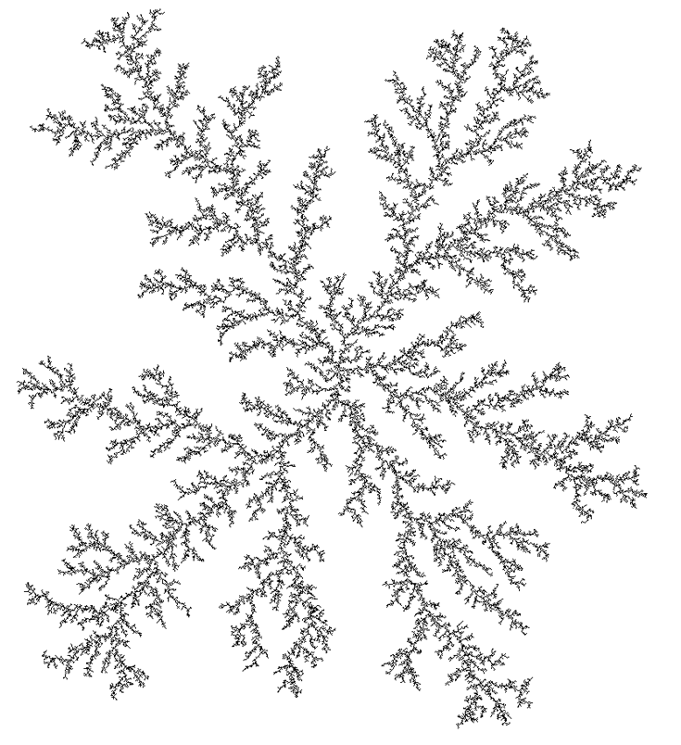
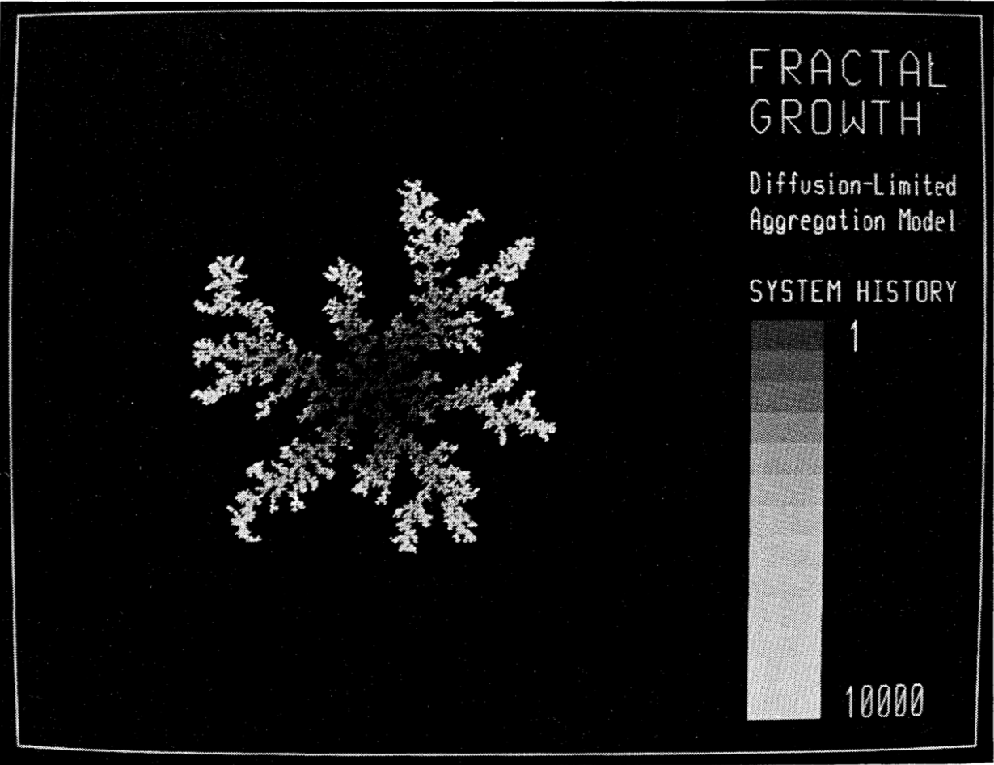
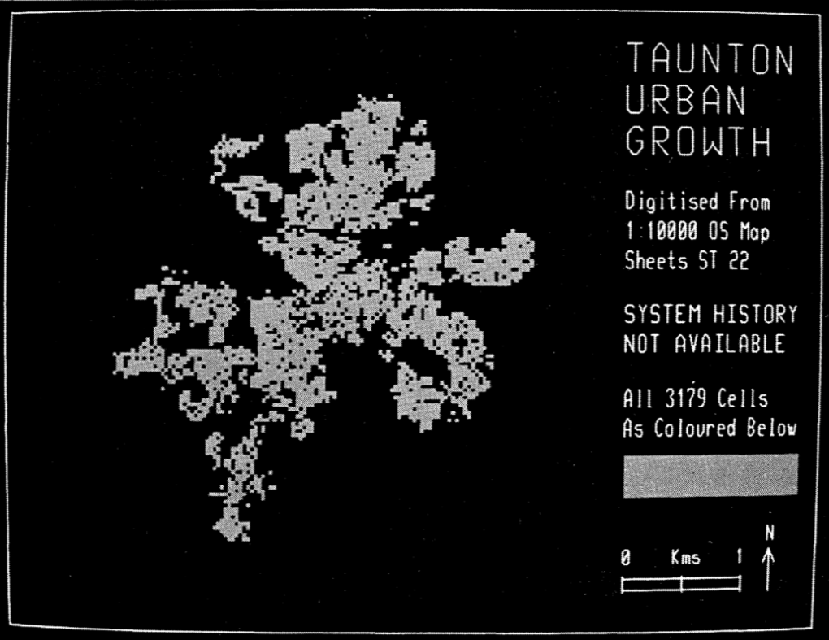
Background
Diffusion-Limited Aggregation
Coral reefs, urban growth…
The process of DLA largely determines the urban geometry
Fractal analysis Network analysis
Batty, et. al, 1989

Slide 3
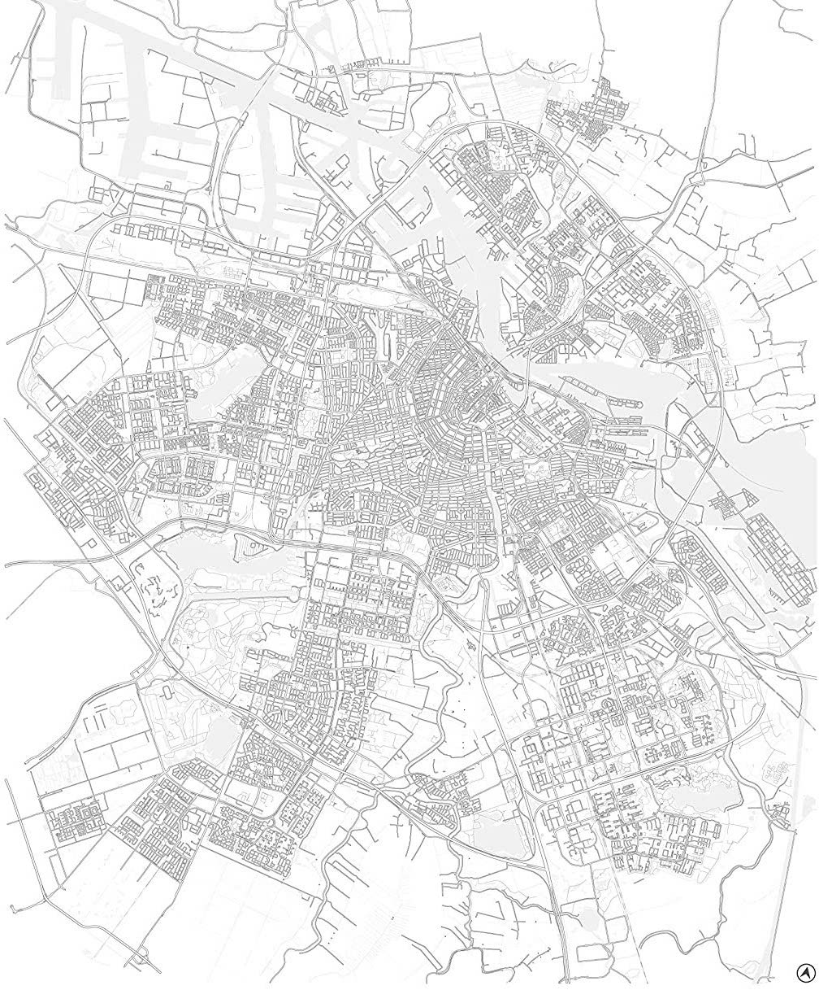
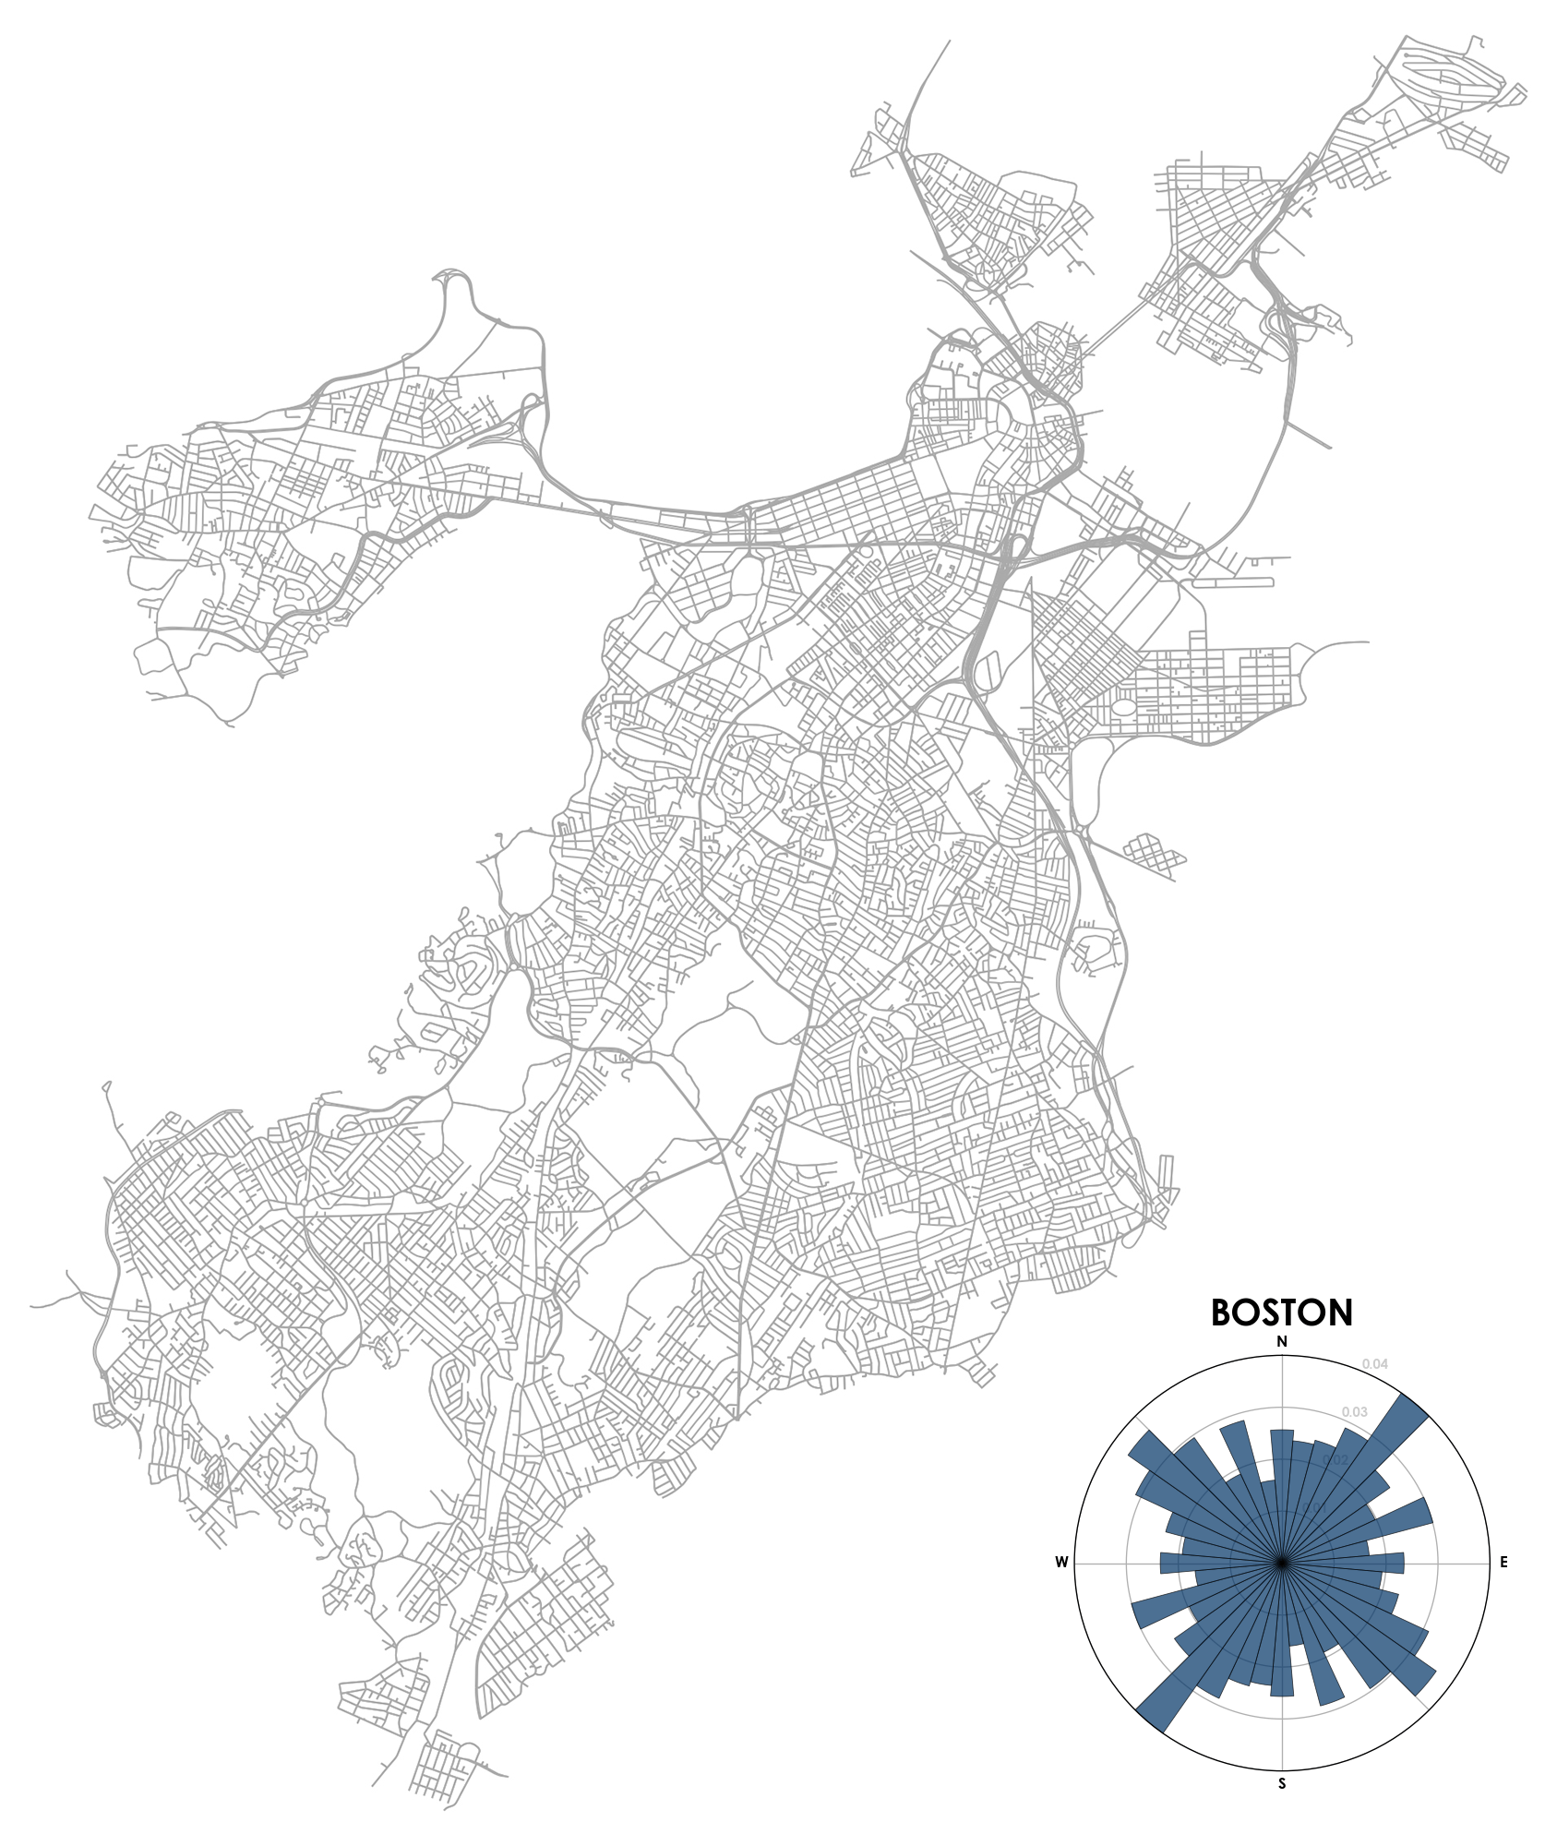
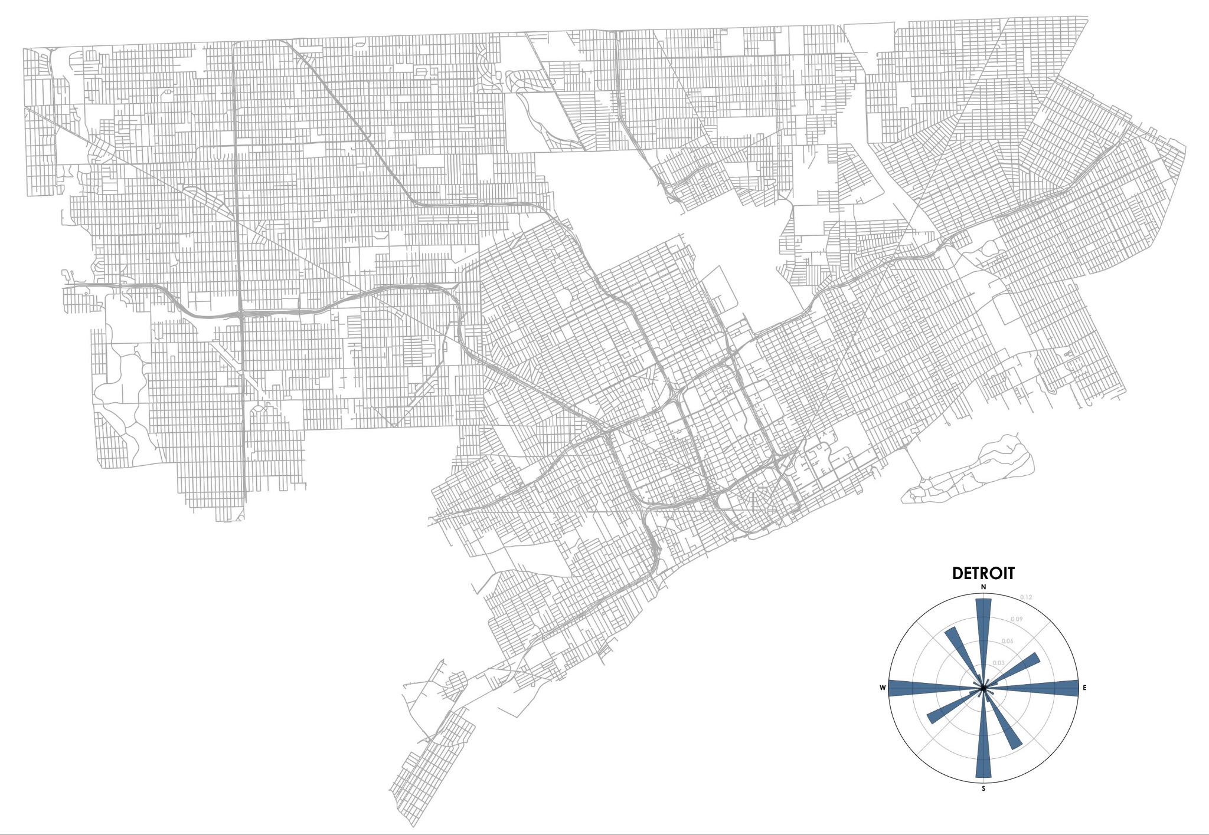
Research Questions
Emergent behavior
How are parameters related to the patterns?
expansion, densification, etc.
Can we simulate the formation of real cities?
Detroit, MI, U.S.
Image by Geoff Boeing
Boston, MA, U.S.
Image by Geoff Boeing
Amsterdam, NL.
Image by Gridlines

Slide 4
Diffusion-Limited Aggregation
Diffusion-limited aggregation (DLA) is the process whereby particles undergoing a random walk due to Brownian motion cluster together to form aggregates of such particles.
Diffusion-limited Aggregates are called brownian trees or fractals.
Applications in modeling of crystal formation, tumor growth and city networks.
Diffusion Limited Aggregation by André Offringa

Slide 5

The DLA Algorithm
Start with a completely empty space (numpy array) and place one particle in it.
Spawn a random walker which will walk through the space until it hits the structure, once that happens it has a probability of Ps of adhering.
Third particle is released and the process repeats until a stopping condition is met.
Diffusion Limited Aggregation by André Offringa

Slide 6
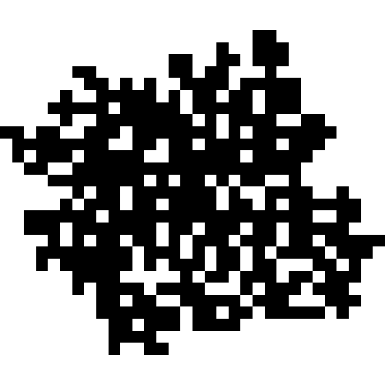
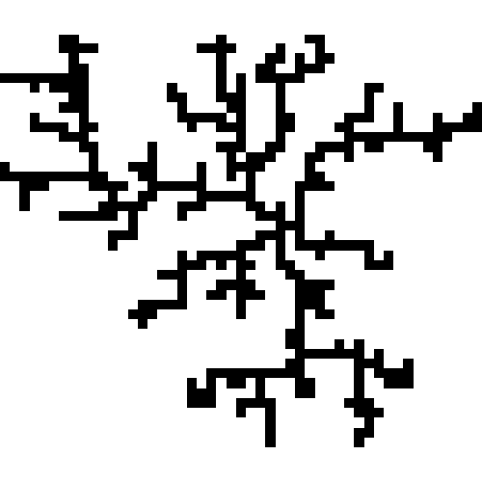
Influence of the sticking probability on the aggregate
Sticking probability = 0.01
Sticking Probability = 1

Slide 7
Notable Implementation Details
Square Lattice DLA is used.
Discretises the space domain
Walkers are bounded in a radius around the aggregate, so walkers can not walk off into the distance.
Yields significant speedup
Diffusion Limited Aggregation by André Offringa

Slide 8
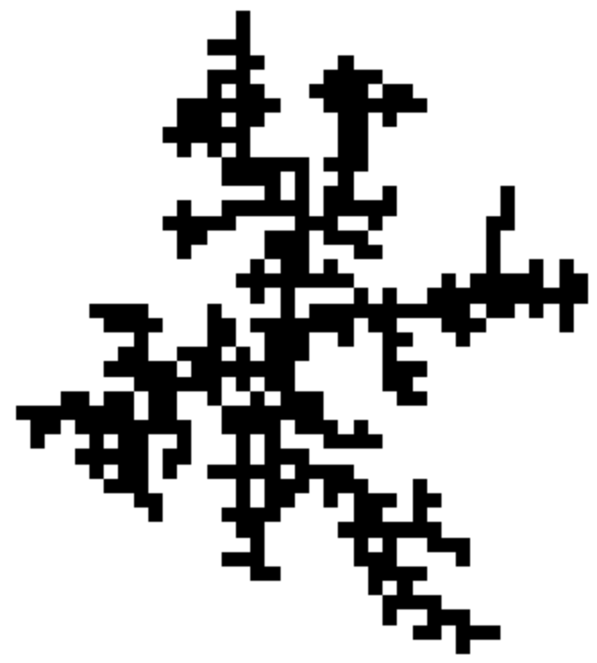
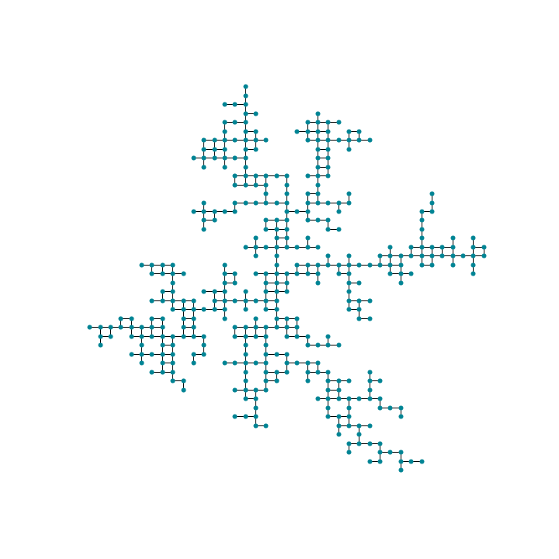
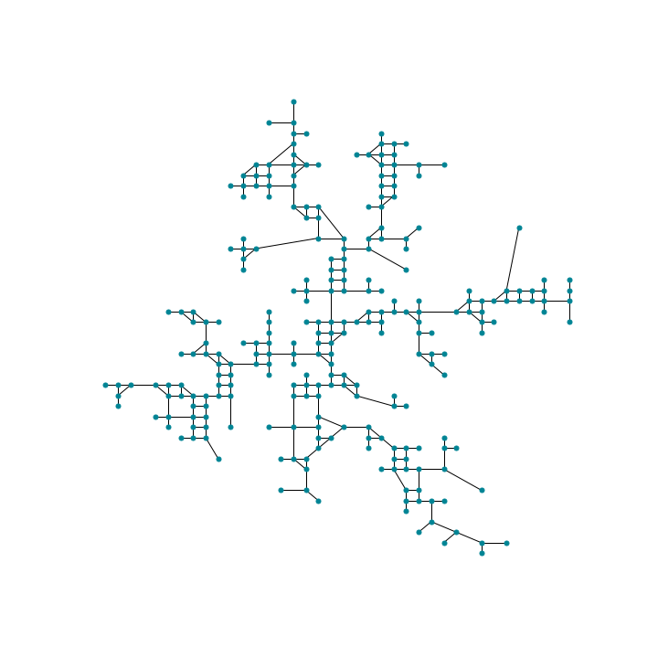
From DLA to networks
1. Generate a binary grid with DLA.
2. Convert each occupied cell into a node and make links between neighbours to the east, west, south and north.
3. Simplify the network by removing nodes of degree = 2.

Slide 9
Network parameters in relation to cities
Average degree (k̂) - measures how many streets on average combine into a junction.
Average clustering (ĉ) - measures how fragmented the city is. Lower clustering - less fractured city.
Diameter (d) - measures how many junction need to be travelled through in the longest shortest path in the city.
Entropy (H) - measures the disorder in the city. Higher entropy - higher variation in the street orientation angles.
Percent 1st degree nodes (P_{de}) - dead-end streets.
Percent 4th degree nodes (P_{4w}) - 4-way junctions.

Slide 10
Comparison with real cities
City | k̂ | ĉ | H | P_{de} | P_{4w}
Bangkok, Thailand | 2.296 | 0.021 | 3.482 | 0.385 | 0.079
Oslo, Norway | 2.741 | 0.094 | 3.578 | 0.170 | 0.116
Riyadh, Saudi Arabia | 3.042 | 0.017 | 3.181 | 0.028 | 0.107
Las Vegas, NV, USA | 2.667 | 0.047 | 2.797 | 0.238 | 0.168
Manila, the Philippines | 3.073 | 0.039 | 3.522 | 0.108 | 0.299
stickiness | k̂ | ĉ | H | P_{de} | P_{4w}
0.005 | 2.936 | 0.089 | 1.210 | 0.153 | 0.259
0.010 | 2.921 | 0.090 | 1.217 | 0.156 | 0.252
0.100 | 2.737 | 0.099 | 1.301 | 0.217 | 0.194
0.300 | 2.551 | 0.104 | 1.425 | 0.271 | 0.130
0.500 | 2.458 | 0.104 | 1.494 | 0.301 | 0.101
0.700 | 2.367 | 0.093 | 1.551 | 0.332 | 0.078
1.000 | 2.278 | 0.082 | 1.633 | 0.366 | 0.055
City network data obtained via OSMnx package on python

Slide 11
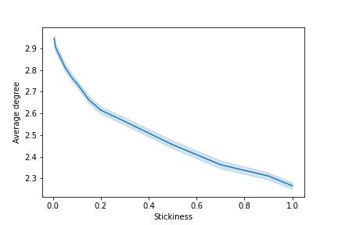
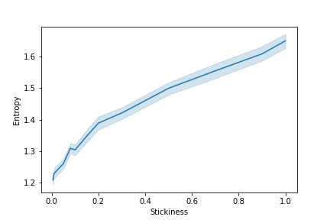
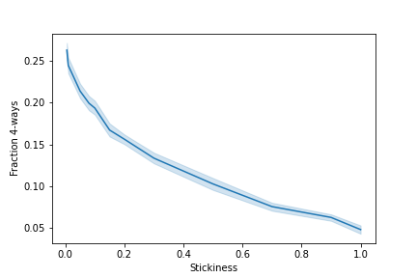
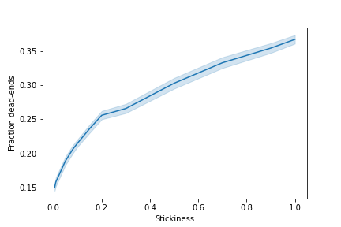
How does stickiness affect network properties?
Average degree
Entropy
Percentage 4-way
Percentage dead-ends
Results: 50 runs with 400 walkers at stickiness = 1, 0.9, 0.7, 0.5, 0.3, 0.2, 0.15, 0.1, 0.08, 0.05, 0.01, 0.005

Slide 12
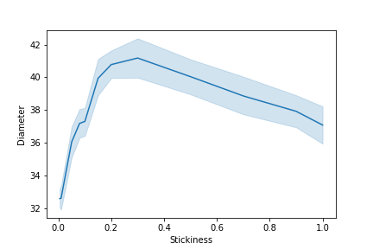
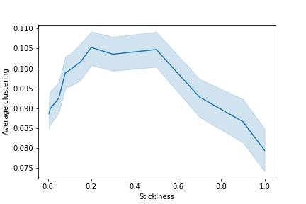
How does stickiness affect network properties?
Diameter
Average clustering
Results: 50 runs with 400 walkers at stickiness = 1, 0.9, 0.7, 0.5, 0.3, 0.2, 0.15, 0.1, 0.08, 0.05, 0.01, 0.005

Slide 13
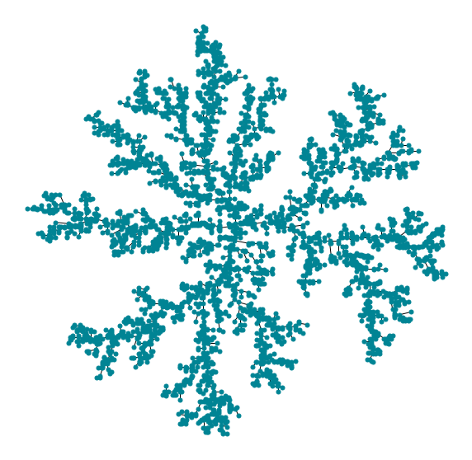
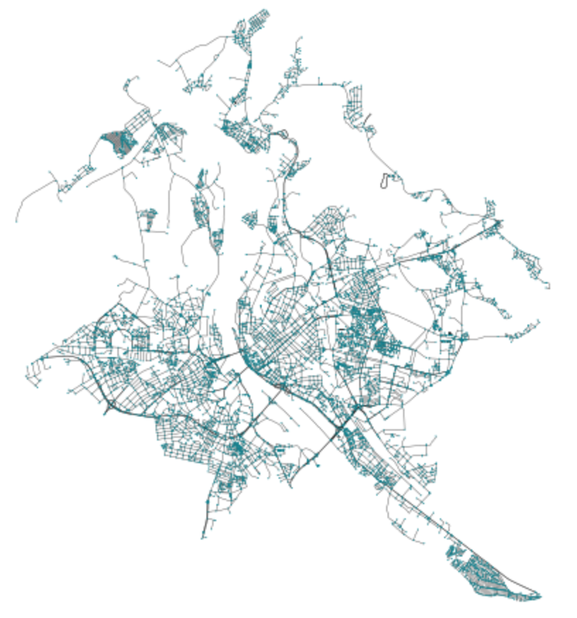
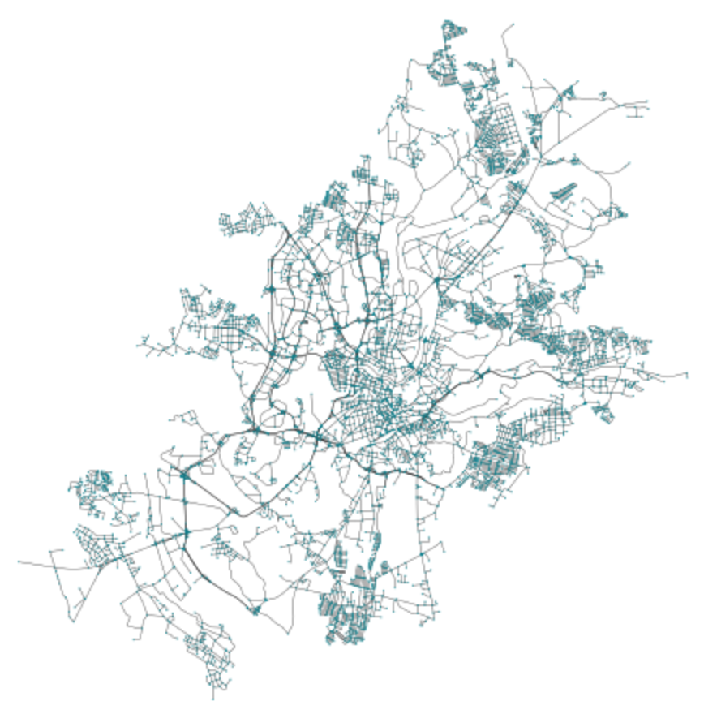
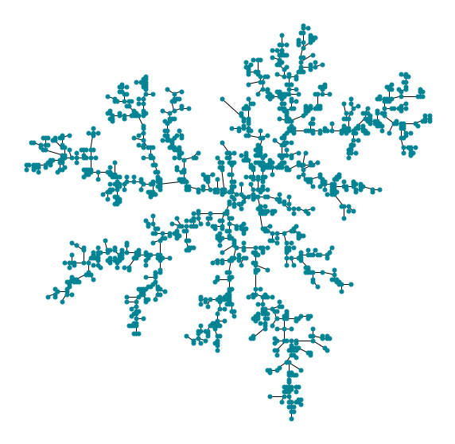
Real city network vs DLA networks
Riga, Latvia
Vilnius, Lithuania

Slide 14
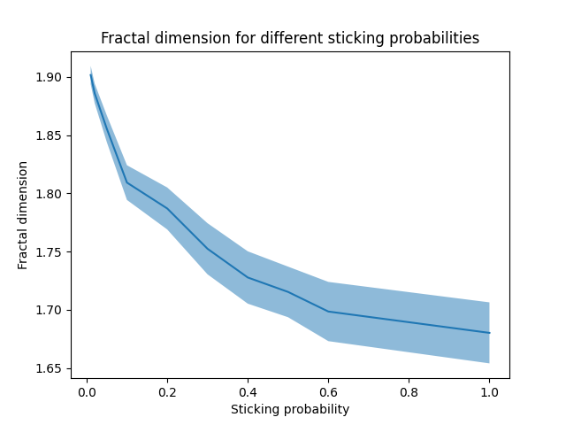
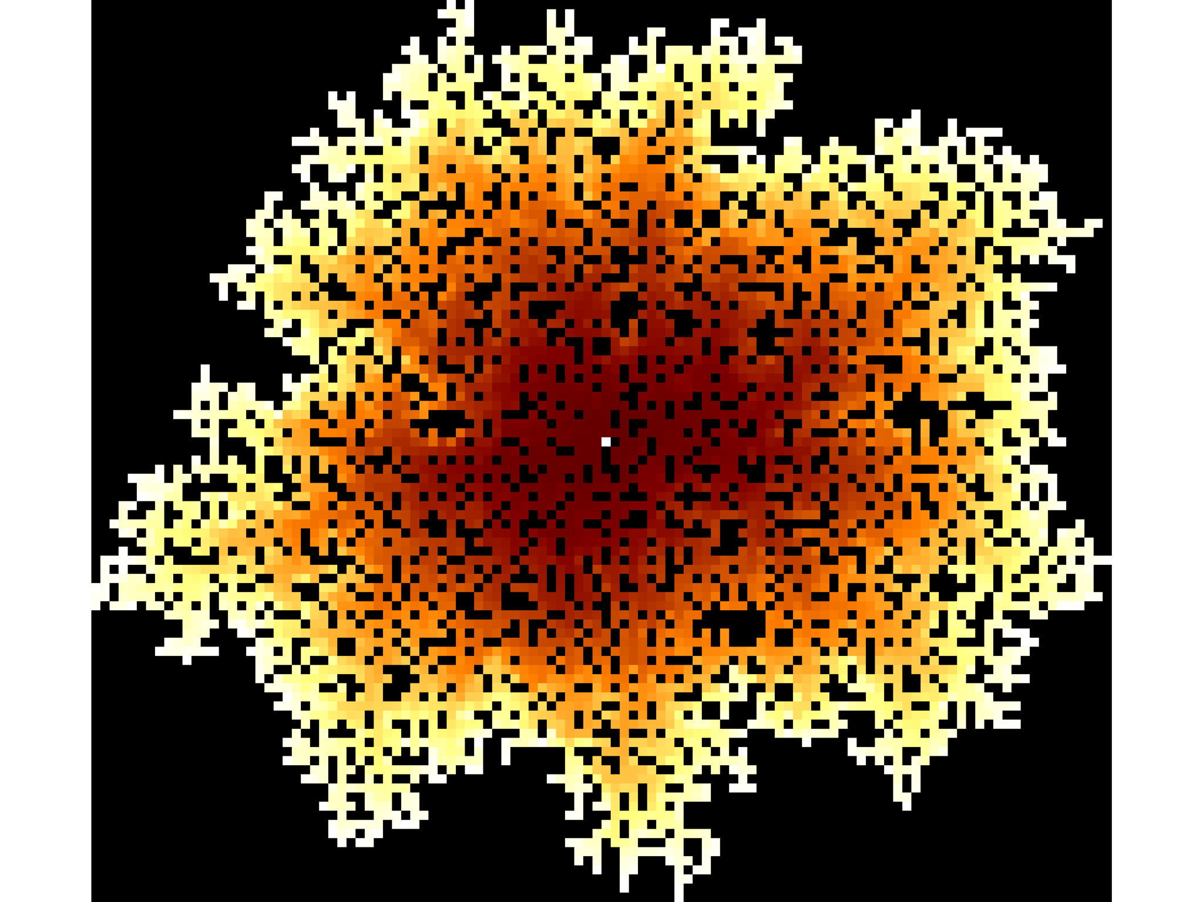
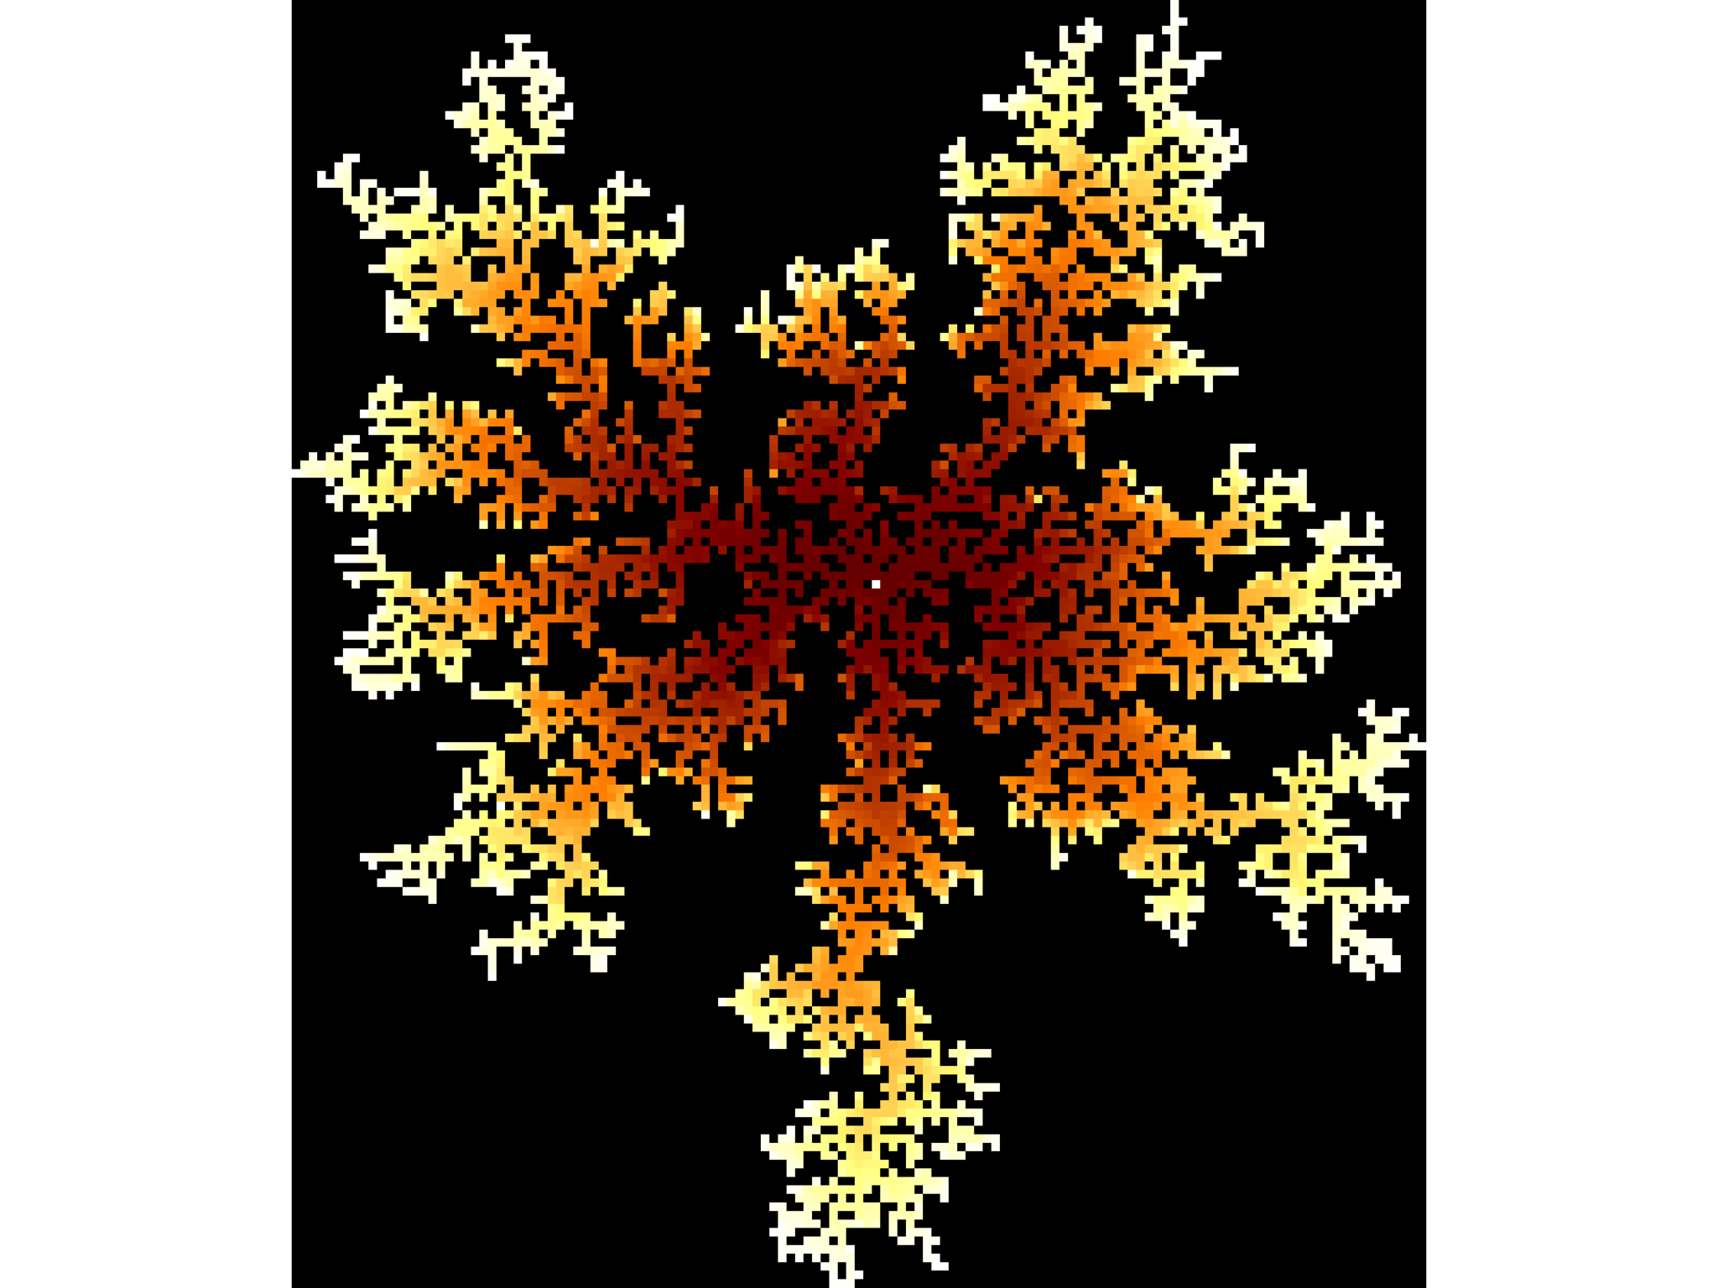
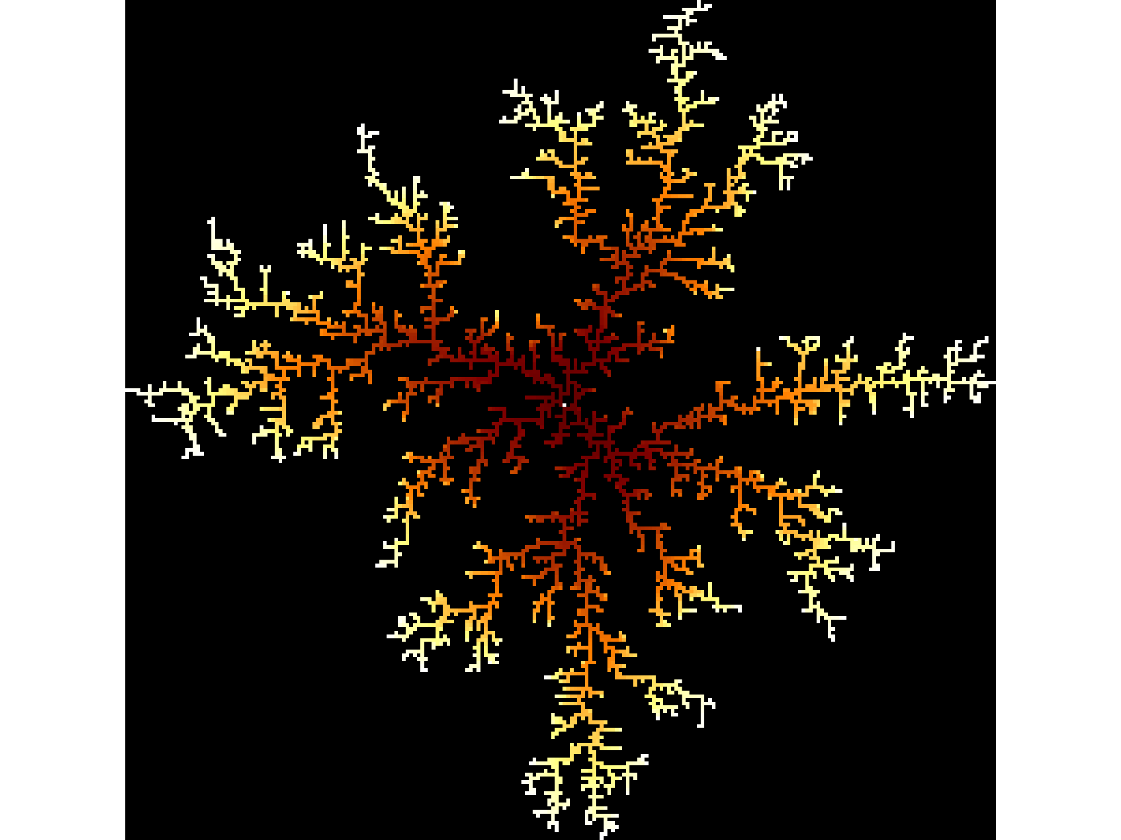
Dynamic stickiness
No DLA structure seems to really resemble a city, even if network results aren’t too far off.
Seems that a city could resemble a mix of lower and higher stickiness in some way.
New idea: dynamic stickiness!
Fixed stickiness -> changing stickiness within same simulation.

Slide 15

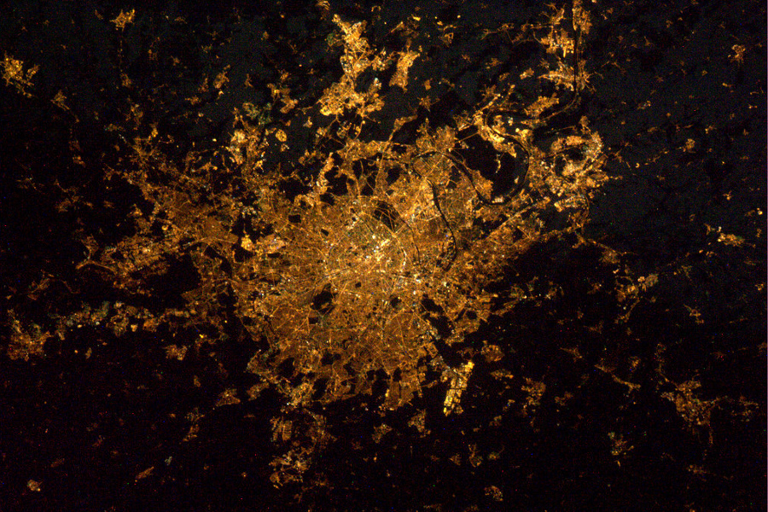
Dynamic stickiness
Form a center -> spread out -> form adjoining neighbourhoods.
Sine wave -> step function.
Recognizable periods of exploration/exploitation or expansion/densification.
Paris at night from ISS. Image from ESA/NASA.

Slide 16
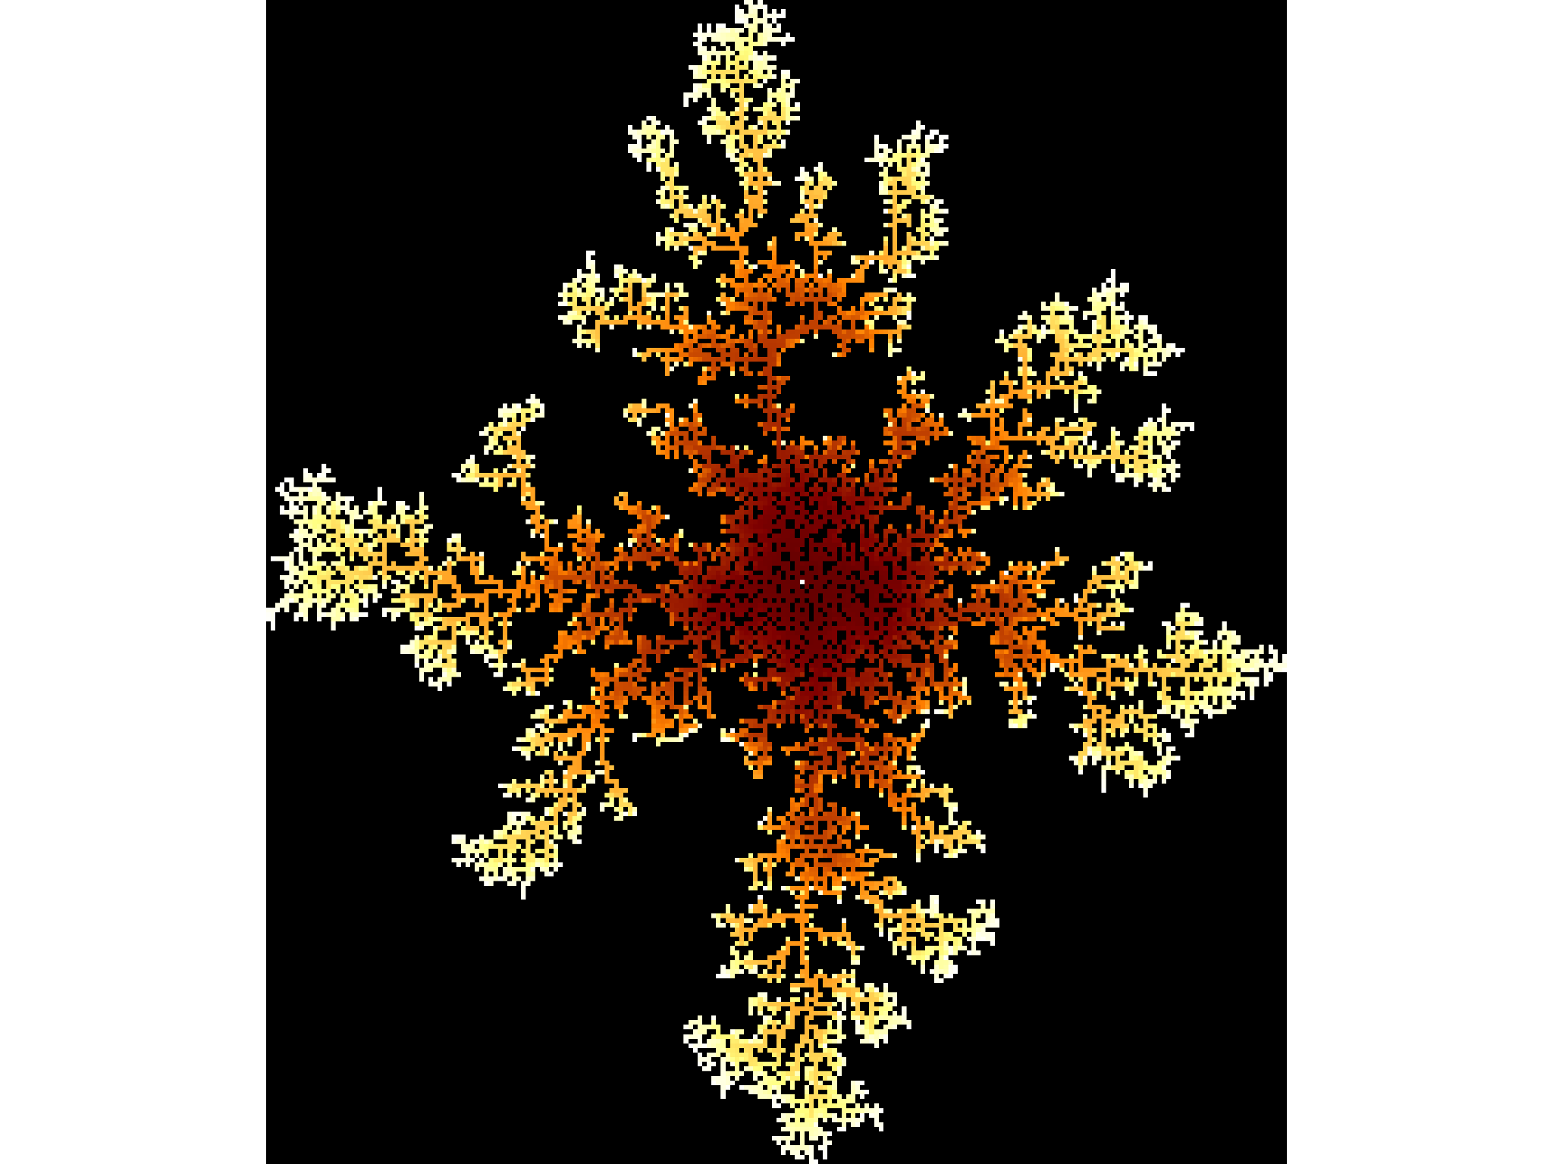
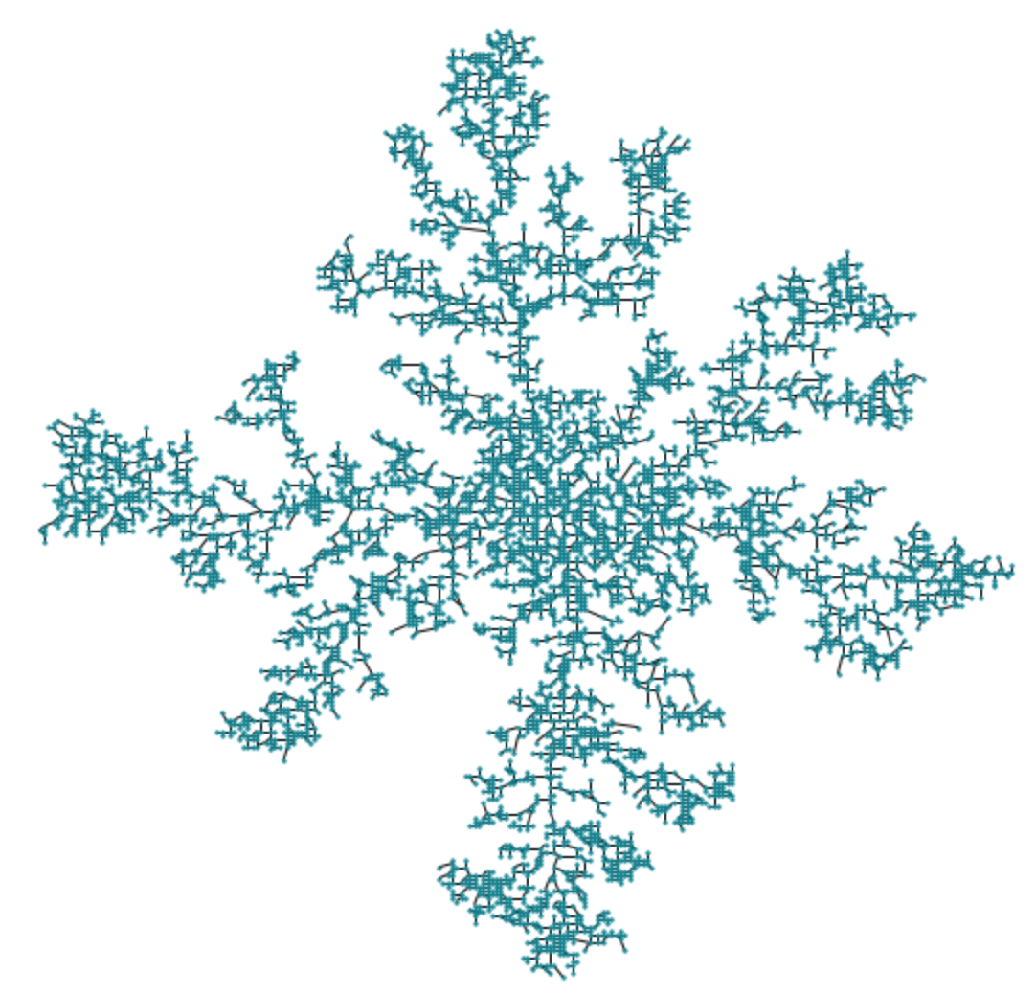
Dynamic stickiness
k̂ | ĉ | H | P_{de} | P_{4w}
2.746761 | 0.100093 | 1.801226 | 0.208205 | 0.18831

Slide 17
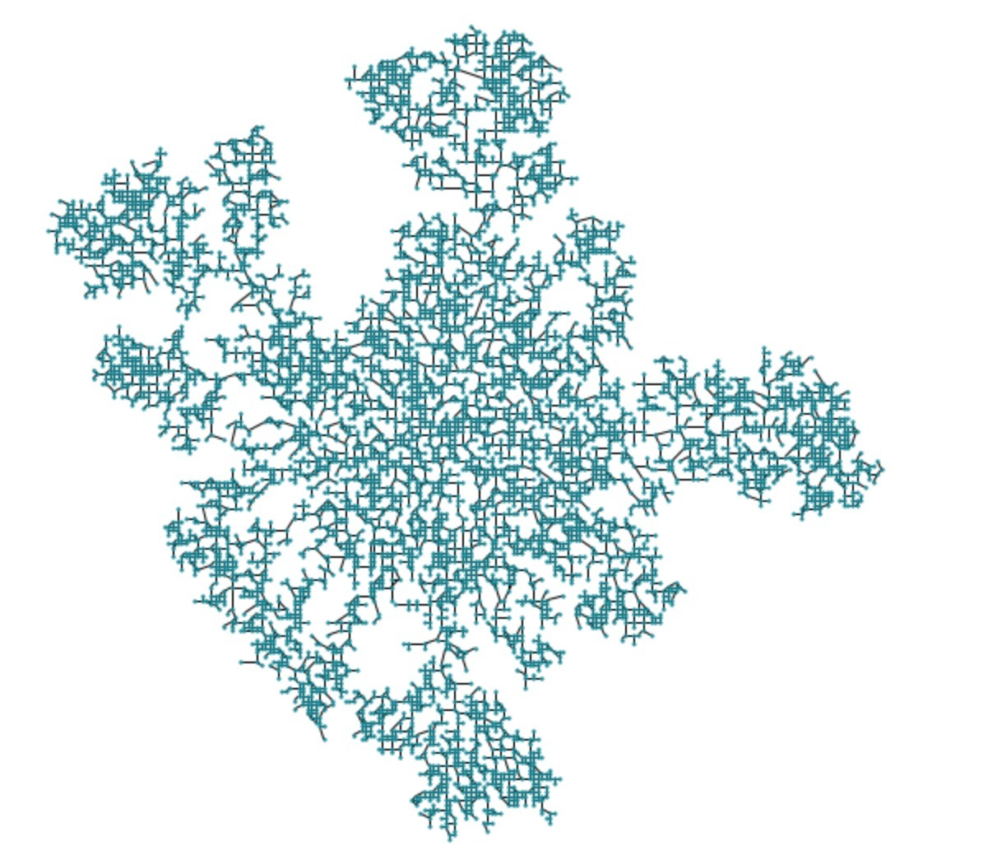
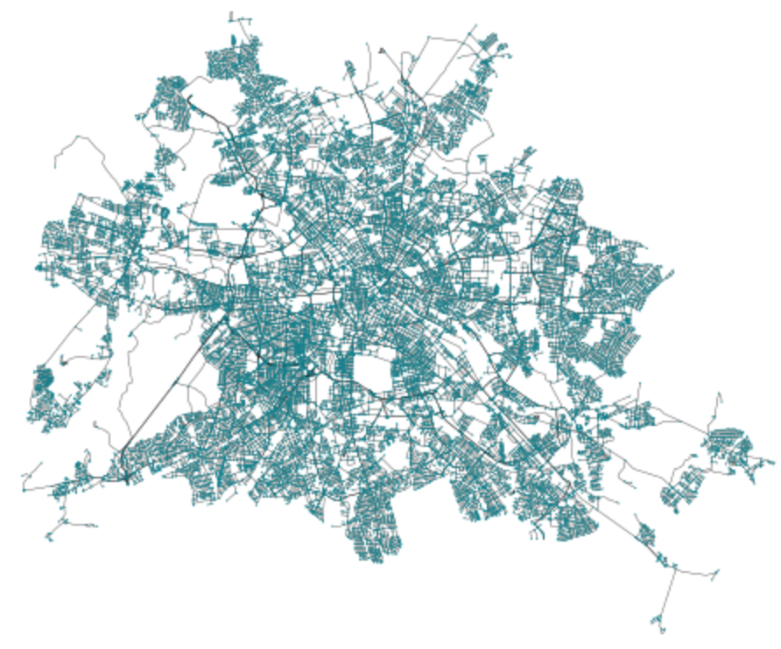
Real city comparison: Berlin

Slide 18
 | Berlin | DLA model
Average degree | 2.998 | 2.910
Clustering | 0.052 | 0.094
Entropy | 3.572 | 1.701
Dead ends | 0.120 | 0.153
4-ways | 0.257 | 0.235
Fractal dimension | 1.845 ± 0.01 | 1.848 ± 0.009

Slide 19
Conclusions
Tried new type of DLA method/analysis and compared results to real cities.
Did we show whether DLA could be used to show city formation? Unclear.
Patterns of networks with dynamic stickiness do resemble city structure visually, but network details are still quite different.
However, we consider using dynamic stickiness a success.
Literature on this subject is extremely scarce, we hope to have contributed at least to some extent.

Slide 20

Future work
To possibly come to better results and more interesting structures, we have some recommendations.
Change grid to hexagonal cells to introduce more freedom of movement, or take even further to continuous space.
Geological structures often get in the way of growth; how would the model react to having no-go zones such as water/mountains?
More experimentation with dynamic stickiness. There are tons of different scalings to try here and could also be combined with different grid spaces.

Slide 21

References
Batty, M., Longley, P., & Fotheringham, S. (1989). Urban growth and form: scaling, fractal geometry, and diffusion-limited aggregation. Environment and planning A, 21(11), 1447-1472.
Boeing, G. (2019). Urban spatial order: Street network orientation, configuration, and entropy. Applied Network Science, 4(1), 1-19.
Halsey, T. C. (2000). Diffusion-limited aggregation: a model for pattern formation. Physics Today, 53(11), 36-41.
Meakin, P. (1983). Formation of fractal clusters and networks by irreversible diffusion-limited aggregation. Physical Review Letters, 51(13), 1119.

Slide 22
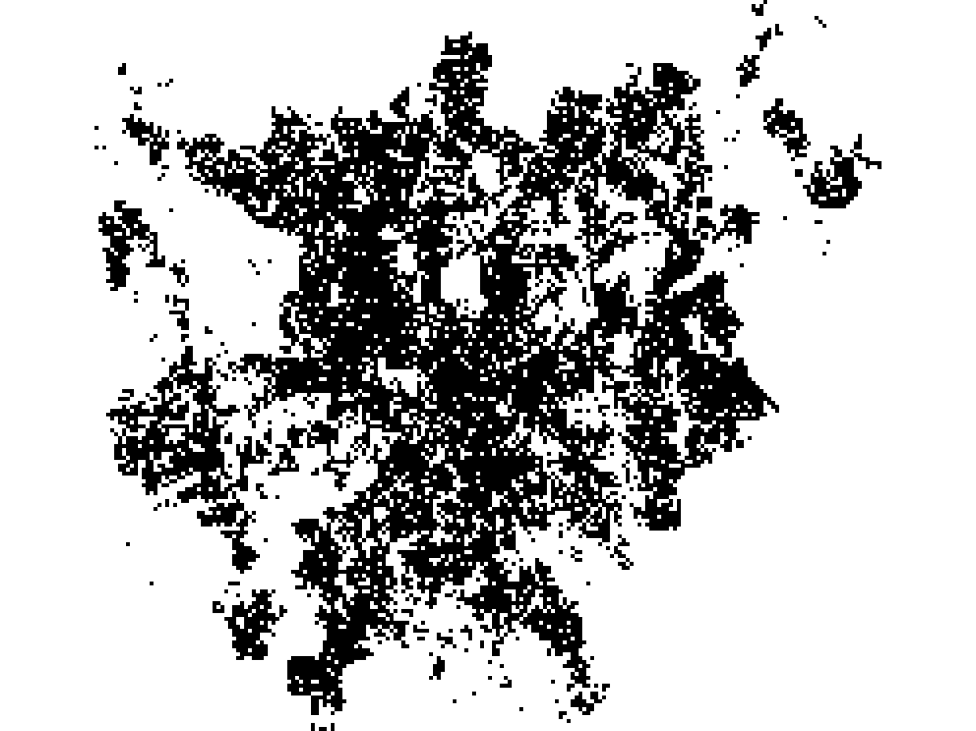
Appendix: From network to fractal

